Slide 1
Election Algorithms and
Distributed Processing
Section 6.5

Slide 2
Outline
Election algorithms – introduction
Traditional election algorithms
  Bully algorithm
  Ring algorithm
Wireless election algorithms

Slide 3
Need for a Coordinator
Many algorithms used in distributed systems require a coordinator
  For example, see the centralized mutual exclusion algorithm.
In general, all processes in the distributed system are equally suitable for the role
Election algorithms are designed to choose a coordinator.

Slide 4
Election Algorithms
Any process can serve as coordinator
Any process can “call an election” (initiate the algorithm to choose a new coordinator).
  There is no harm (other than extra message traffic) in having multiple concurrent elections.
Elections may be needed when the system is initialized, or if the coordinator crashes or retires.

Slide 5
Assumptions
Every process/site has a unique ID; e.g.
  the network address
  a process number
Every process in the system should know the values in the set of ID numbers, although not which processors are up or down.
The process with the highest ID number will be the new coordinator.
Process groups (as with ISIS toolkit or MPI) satisfy these requirements.

Slide 6
Requirements
When the election algorithm terminates a single process has been selected and every process knows its identity.
Formalize: every process p_{i} has a variable e_{i} to hold the coordinator’s process number.
  ∀i, e_{i} = undefined or e_{i} = P, where P is the non-crashed process with highest id
  All processes (that have not crashed) eventually set e_{i} = P.

Slide 7
The Bully Algorithm - Overview
Process p calls an election when it notices that the coordinator is no longer responding.
High-numbered processes “bully” low-numbered processes out of the election, until only one process remains.
When a crashed process reboots, it holds an election. If it is now the highest-numbered live process, it will win.

Slide 8
Figure 6-20
1
1
5
5
2
2
election
OK
6
6
4
election
4
OK
election
3
3
0
0
7
7
Process p sends an election message to all higher-numbered processes in the system.
If no process responds, then p becomes the coordinator.
If a higher-level process (q) responds, it sends p a message that terminates p’s role in the algorithm

Slide 9
The process q now calls an election (if it has not already done so).
Repeat until no higher-level process responds. The last process to call an election “wins” the election.
The winner sends a message to other processes announcing itself as the new coordinator.
1
5
2
election
6
4
election
election
0
3
7
1
Figure 6-20
5
1
2
5
OK
2
4
6
6
4
coordinator
0
3
3
0
7
7
If 7 comes back on line, it will call an election

Slide 10
1
1
1
5
5
5
2
2
2
election
election
OK
6
6
6
4
election
4
4
OK
election
election
election
3
3
3
0
0
0
7
7
7
1
5
1
2
5
OK
2
4
6
6
4
coordinator
0
3
3
0
7
7
Figure 6-20

Slide 11
Analysis
Works best if communication in the system has bounded latency so processes can determine that a process has failed by knowing the upper bound (UB) on message transmission time (T) and message processing time (M).
  UB = 2 * T + M
However, if a process calls an election when the coordinator is still active, the coordinator will win the election.

Slide 12
A Ring Algorithm - Overview
The ring algorithm assumes that the processes are arranged in a logical ring and each process is knows the order of the ring of processes.
Processes are able to “skip” faulty systems: instead of sending to process j, send to j + 1.
Faulty systems are those that don’t respond in a fixed amount of time.

Slide 13
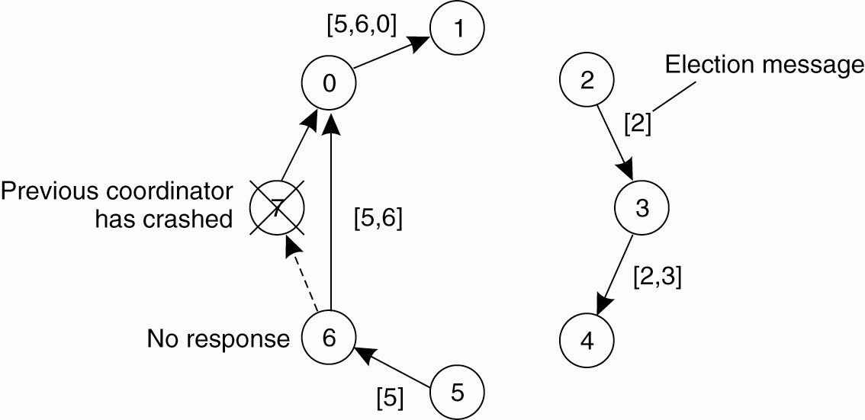
A Ring Algorithm
P thinks the coordinator has crashed; builds an ELECTION message which contains its own ID number.
Sends to first live successor
Each process adds its
own number and
forwards to next.
OK to have two
elections at once.

Slide 14
Ring Algorithm - Details
When the message returns to p, it sees its own process ID in the list and knows that the circuit is complete.
P circulates a COORDINATOR
message with the new high
number.
Here, both 2 and 5
elect 6:
[5,6,0,1,2,3,4]
[2,3,4,5,6,0,1]

Slide 15
Elections in Wireless Environments
Traditional algorithms aren’t appropriate.
  Can’t assume reliable message passing or stable network configuration
This discussion focuses on ad hoc wireless networks but ignores node mobility.
  Nodes connect directly, no common access point, connection is short term
  Often used in multiplayer gaming, on-the-fly file transfers, etc.

Slide 16
Assumptions
Wireless algorithms try to find the best node to be coordinator; traditional algorithms are satisfied with any node.
Any node (the source) can initiate an election by sending an ELECTION message to its neighbors – nodes within range.
When a node receives its first ELECTION message the sender becomes its parent node.

Slide 17
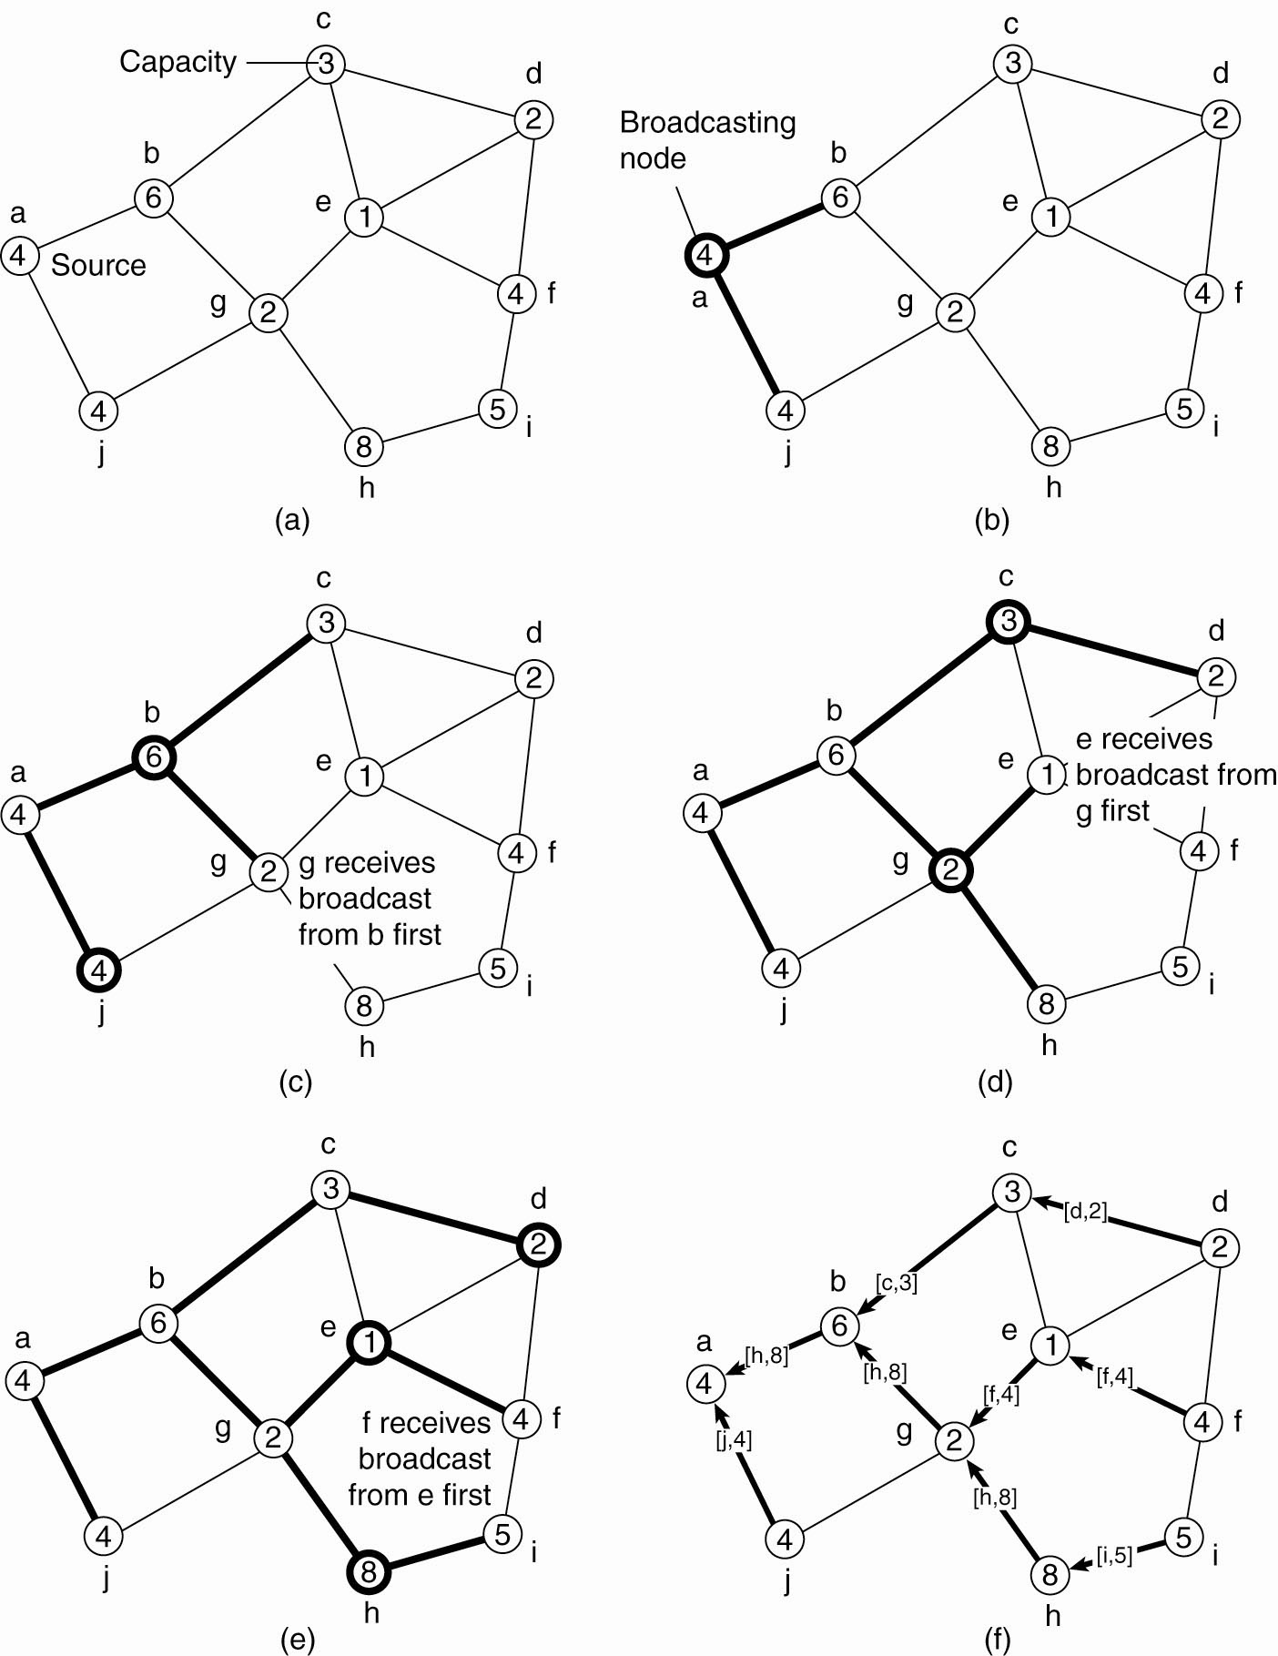
Figure 6-22.
Node a is the source.
Messages have a unique ID to manage possible concurrent elections

Slide 18
Figure 6.22
Figure 6-22. Election algorithm in a wireless network, with node a as the source. (a) Initial network. (b)–(e) The build-tree phase
When a node R receives its first election message, it designates the source Q as its parent, and forwards the message to all neighbors except Q.
When R receives an election message from a non-parent, it just acknowledges the message

Slide 19
Figure 6-22. (e) The build-tree phase.
(f) Reporting of best node to source.
If R’s neighbors have parents, R is a leaf; otherwise it waits for its children to forward the message to their neighbors.
When R has collected acks from all its neighbors, it acknowledges the message from Q.
Acknowledgements flow back up the tree to the original source.

Slide 20
Wireless Elections
At each stage the “most eligible” or “best” node will be passed along from child to parent.
Once the source node has received all the replies, it is in a position to choose the new coordinator.
When the selection is made, it is broadcast to all nodes in the network.

Slide 21
Wireless Elections
If more than one election is called (multiple source nodes), a node should participate in only one.
Election messages are tagged with a process id.
If a node has chosen a parent but gets an election message from a higher numbered node, it drops out of the current election and adopts the high numbered node as its parent. This ensures only one election makes a choice.

Slide 22
Chapter 6 - Summary
“Synchronization is … doing the right thing at the right time.”
Synchronization in distributed systems is related to communication.
Complicated by lack of global clock, shared memory.
Logical clocks support global event order.
Distributed mutex: important class of synchronization algorithms.
Leader election algorithms are sometimes needed.

